Slide 1
Analysis of Brand
(Test)
by Yelizaveta Kaminskaya

Slide 2
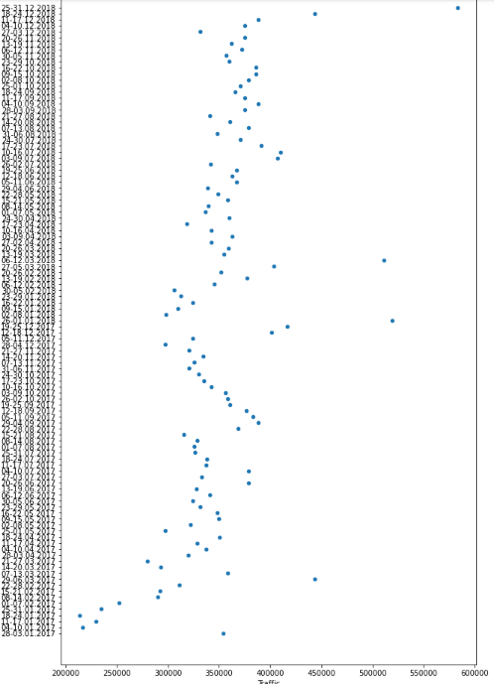
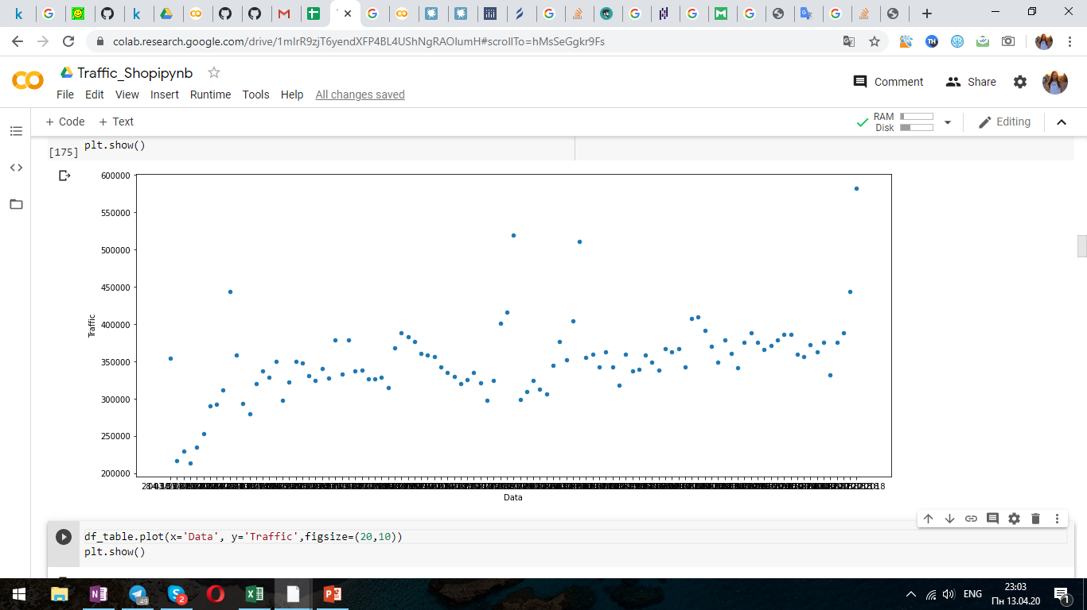
Firstly, we need to analyze how changes our traffic by dates.
At those scatter plots we can see that the most traffic we got before and during holidays like Worldwide Woman Day(nearly 8th of March), Christmas and New Year
(second part of December-first part of January).

Slide 3
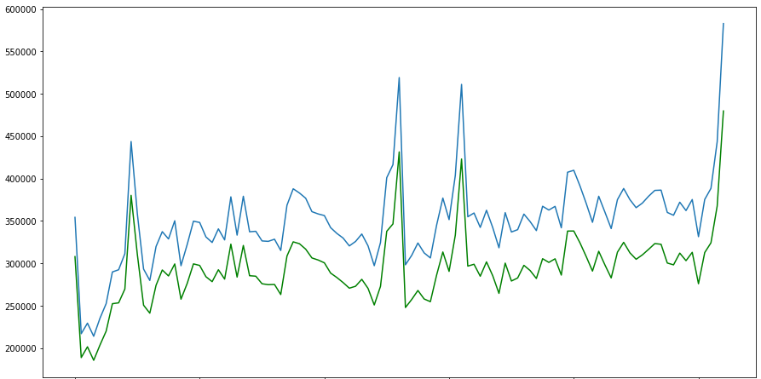
Lets compare the amount of traffic and total transaction per date:
the total transactions is a bit lower than traffic and it is very common.
Also we can see that there are increasing both traffic and transactions on holidays that we discussed on the previous slide.
In total we notice that there is a growth trend.

Slide 4
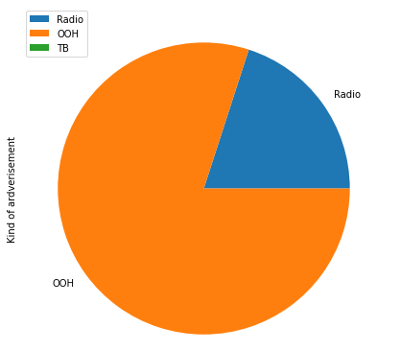
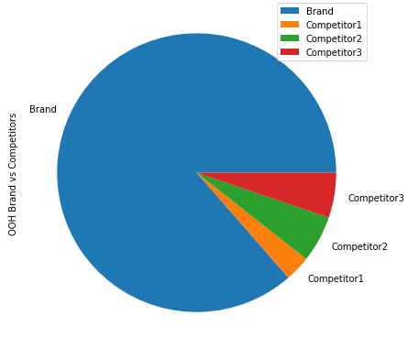
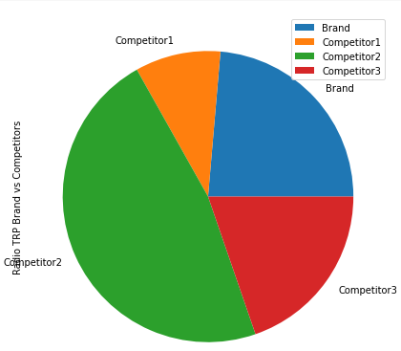
At the first diagram we see that the biggest part of our brand`s advertisement belong to OOH, lower part –to Radio, but we haven`t got any TB TRP.
Second diagram shows that our brand is on the first place in OOH TRP.
At the last one diagram our brand took the second place in Radio TRP, the first is Competitor 2.

Slide 5
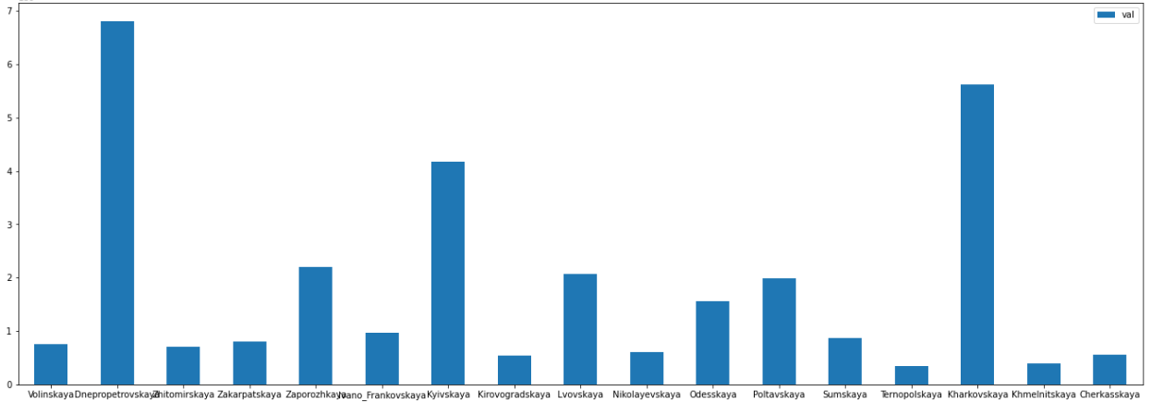
On that graph we can see that we have the biggest amount of transaction in Dnepropetrovskaya, Kharkovskaya and Kyivskaya areas, and the less amount is in Ternopolskaya and Khmelnitskaya
areas.
Lets consider that areas in more details on the next slide.

Slide 6
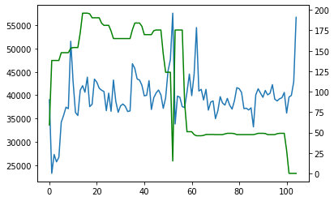
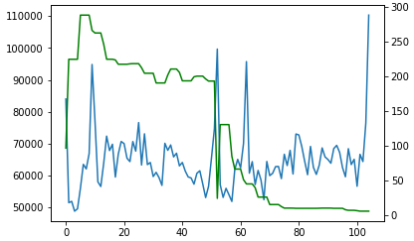
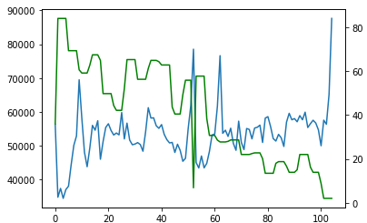
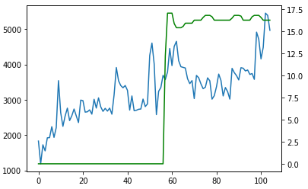
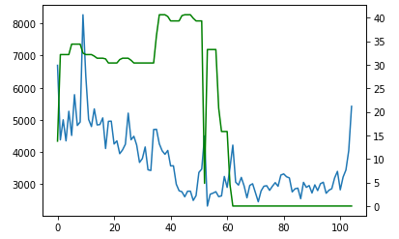
Now lets look how traffic depends on amount of OOH advertisement.
At first three graphs we have areas with the highest traffic and highest level of OOH. Firstly we had more advert. than now, but our traffic is still almost at the same level.
If we look on the last two graphs, we see another situation. In Ternopolskaya area we see upward trend since the time when we’ve started to advertise our brand. And in Khmelnitskaya area our traffic was going down as amount of advertisement.
Kyivskaya
Dnepropetrovskaya
Kharkovskaya
Ternopolskaya
Khmelnitskaya

Slide 7
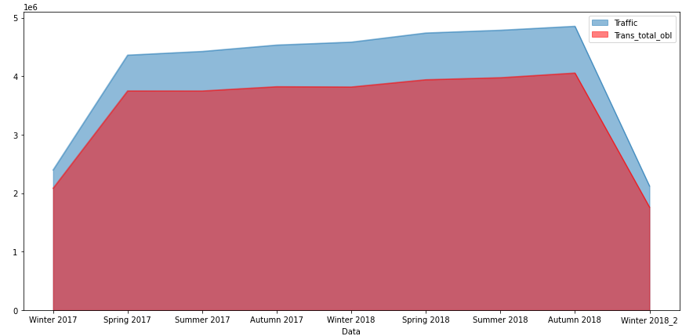
Lets analyze how changes our traffic and total amount of transactions per season.
That plot shows that there is no sharp increasing or decreasing per season
(we have lower results in winter2017-winter2018_2 only because our data contains only half of season)
In total we have gradual growth of traffic and transactions as we’ve seen before.

Slide 8
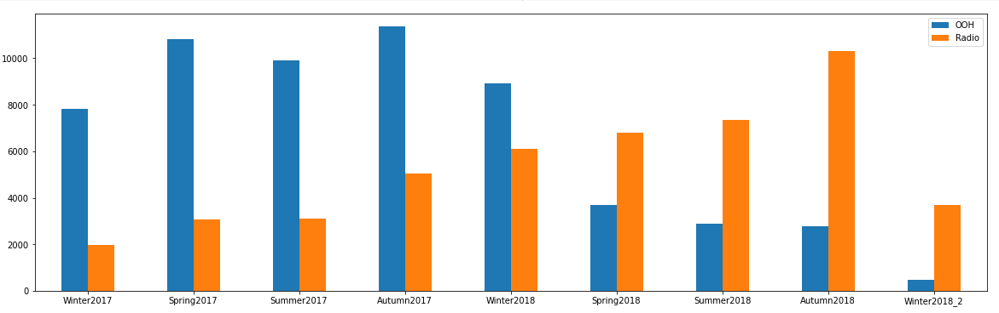
On this graph we compare amount of OOH TRP and Radio TRP by seasons.
We have more OOH till spring 2018, after that Radio TRP was dominated.

Slide 9
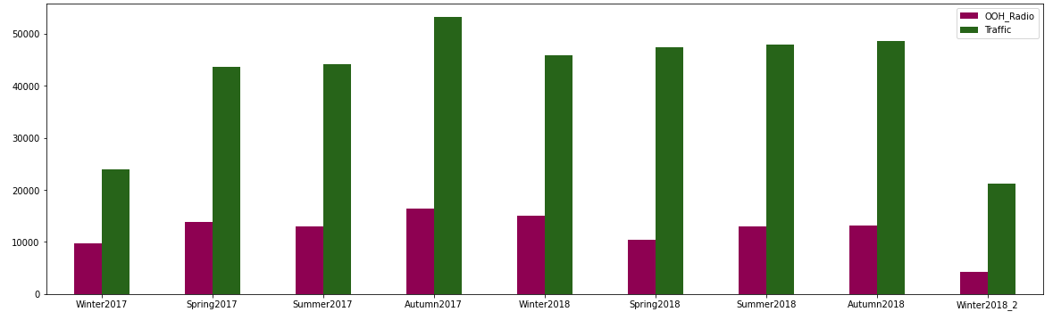
At this bar plot we can see that the biggest amount of Traffic and OOH+Radio TRP is in Autumn2017.
Generally there is the almost the same level of Traffic in total over seasons.

Slide 10
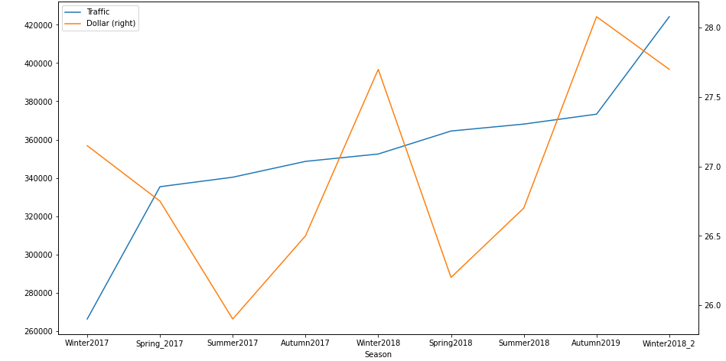
Lets consider impact of dollar rate on Traffic.
In total there is no strong dependence from dollar rate, but this can be explained by the fact that there wasn’t big dollar’s jumps over this period

Slide 11
Conclusions:
In total we observe increasing of Traffic and amount of transactions over days since January 2017 till January 2019. The largest increasing is before and during holidays when people actively looking for presents.
Also there is not huge superiority of traffic compare to amount of transactions.
Biggest part of our brand belongs to OOH TRP, also we have Radio TRP and no TB TRP. In comparison with other competitors out brand holds a strong position.
Considering macro factors we can make a conclusion that traffic has no strong dependence on dollar’s rate and seasons, only holiday’s addition.

